Slide 1
Global goals – Saying no to poverty
Victoria Șerban
Colegiul Național Gheorghe Lazăr, Sibiu

Slide 2
Brainstorming – world problems (think of/write as many global issues as you can think of in 2 minutes)

Slide 3
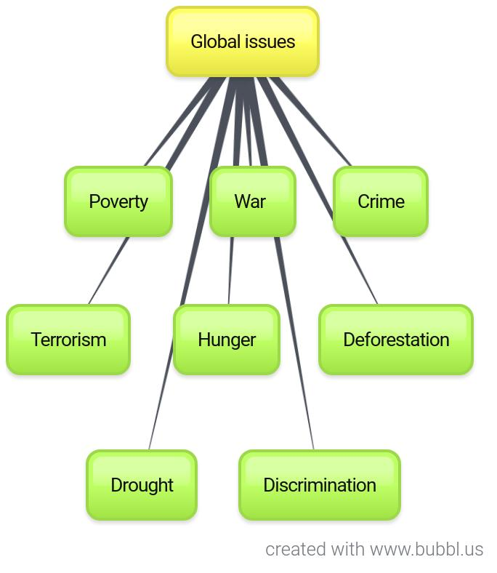

Slide 4
Which of these problems affect Romania? Click on each of them to check your guesses (a faint chime means ‘not really’, a drum means ‘definitely yes’)
Terrorism
Poverty
War
Discrimination
Crime

Slide 5
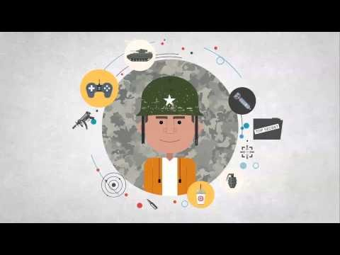
Watch the videos below and make notes on the causes and forms of poverty

Slide 6
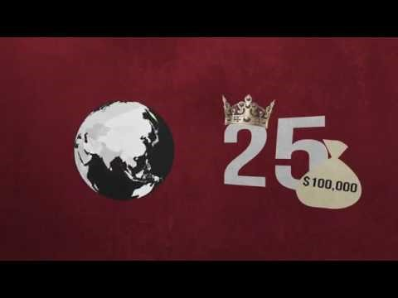

Slide 7
Project (group) work
find/suggest solutions that would help end poverty both locally and globally
use computers or your phones to research the topic
start discussing ways of presenting your findings – you can use Google Docs (https://www.google.com/docs/about/) to collect your ideas
create presentations on alleviating the problem of local and global poverty, using different tools (Storyboardthat – www.storyboardthat.com, Smore – www.smore.com, Prezi – www.prezi.com)
Post your presentations on a common Padlet – www.padlet.com

Slide 8
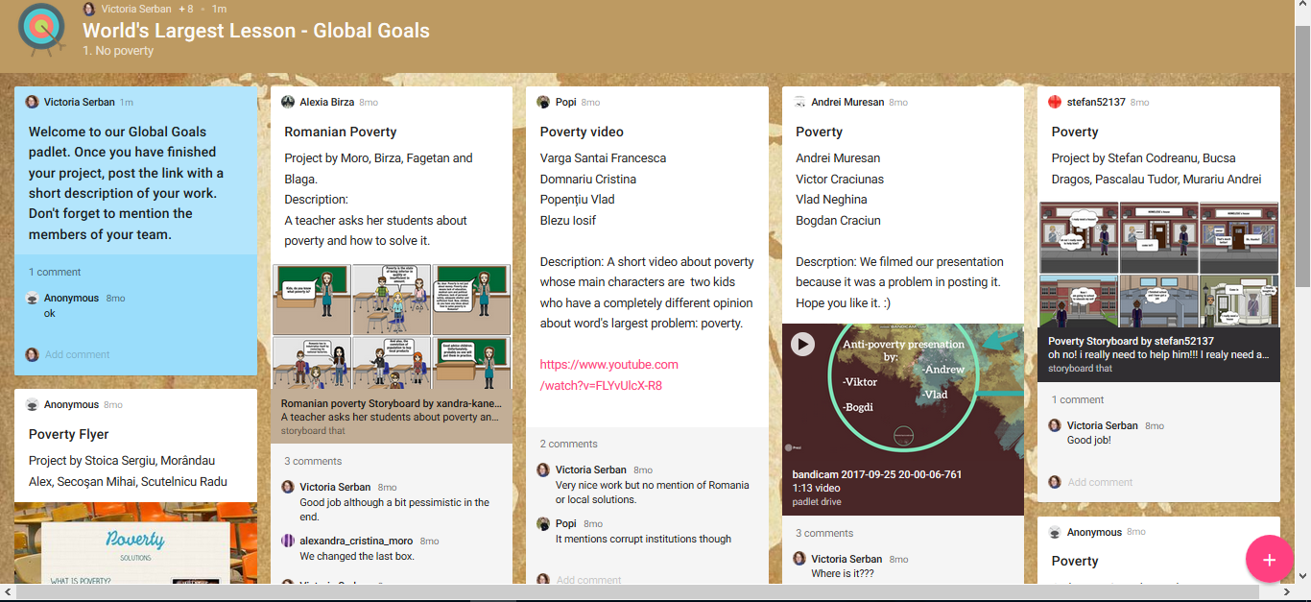

Slide 9
Self and peer assessment
Self assessment for group work (Google form): https://docs.google.com/forms/d/e/1FAIpQLSdZNJffvNTKiMy2csMXcPSsLKOlf2TrTXB5eme3G3BVjX59Lw/viewform
Peer assessment for group work (Google docs): https://docs.google.com/document/d/17GFz6qB-k_Kw_vH6GngbfLFb2Db4xFkki0FD1BeFpuk/edit

Slide 10
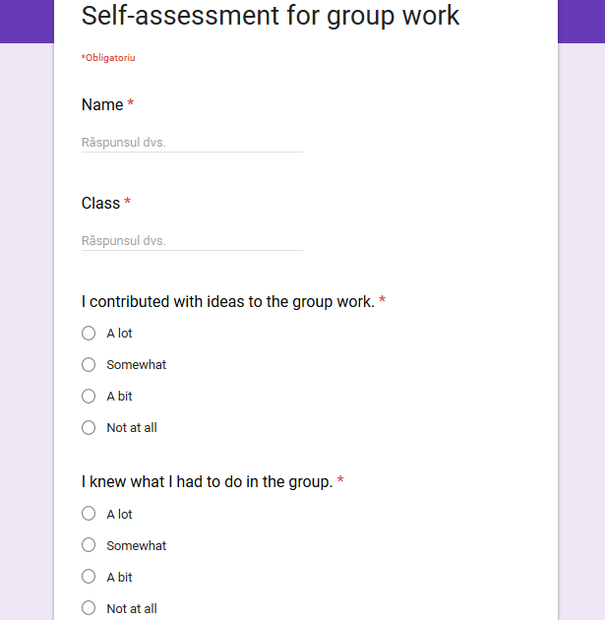
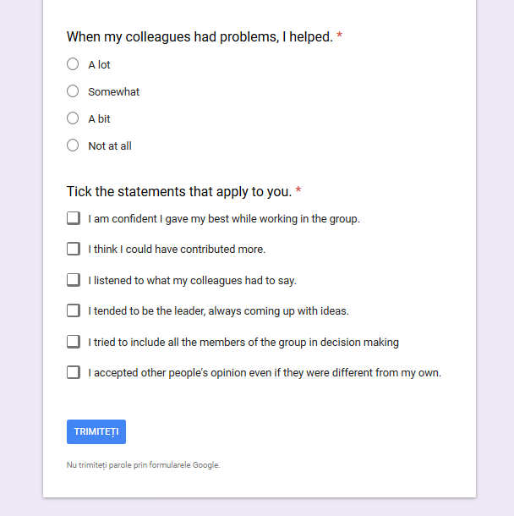

Slide 11
